Slide 1
Educational support
By Karene C Matoka Nana

Slide 2
According to an article published by the National Science Foundation(NSF) in 2014, they reported that 55% more students are failing from traditional lectures compared to those focusing on active learning.
Notes:
They were interested in the failure rates for students majoring in Science, Technology, Engineering, and Mathematics (STEM).

Slide 3
MY SOLUTION
How: Design a database to track the performance of students from those majors after receiving support.
Why: Ensure that each student reach an overall success rate of 80%.
What: Each student who did not receive a good grade on their latest quizzes will be assigned extra exercises.

Slide 4
Our research questions
Based on each department, how many students will need extra practice?
2. Which departments have the most success rate? failure rate?
3. Which subjects are the most difficult for students to assimilate based on the failure rate?
4. What are the success rate and failure rate based on the course?
5. What is the success rate and failure rate after providing the additional exercises?
6. What is the profile of the students who need extra support based on gender and their year of birth?

Slide 5



ABOUT OUR DATA CONSISTS OF
Departments
Professors
Students
Courses
Quizzes
Exams
Additional Practices

Slide 6
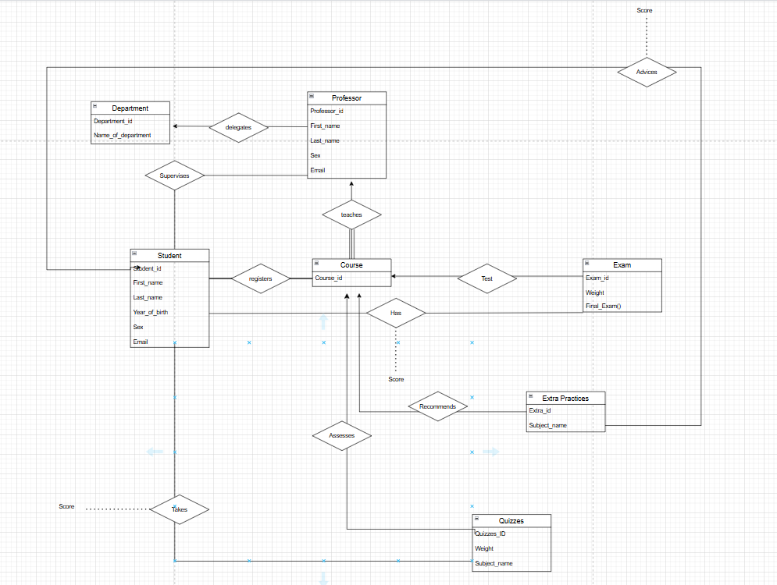
The E-R DIAGRAM is as follow:
Entity:
Department
Professor
Student
Course
Exam
Extra Practices
Quizzes
Relation:
Department delegates a professor
Professor supervises a student
Professor teaches a course
Student takes quizzes
Student takes exams
Student registers for classes
Students can be advice to do extra practices
Each course might recommend extra practices
Each course has two exams
Each course has 4 quizzes

Slide 7
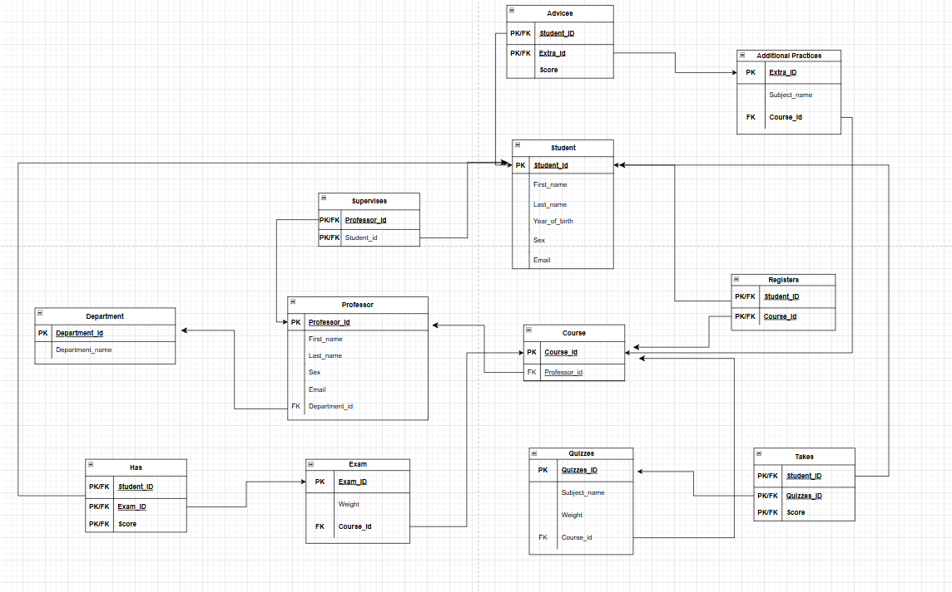
Relational DB DIAGRAM

Slide 8
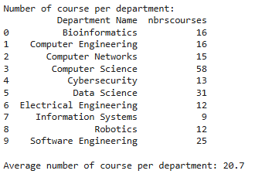
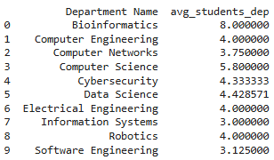
DIAGNOSTIC
Number of Courses per department
Number of Students on average per course per department

Slide 9
DIAGNOSTIC

Slide 10
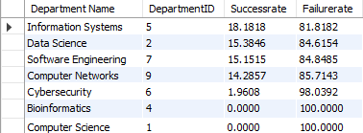
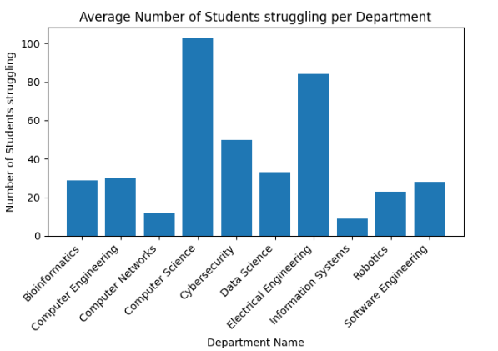
How many students are struggling per department BASED ON QUIZZES RESULTS?
The success and failure rates of the quizzes
Department’s Average Number

Slide 11
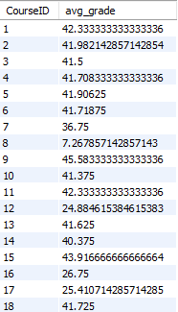
What is the average weighted quizzes score per course?

Slide 12
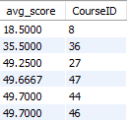
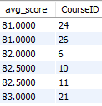
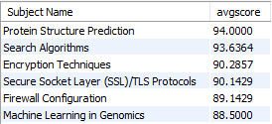
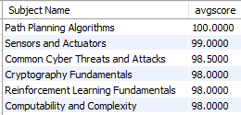
How successful are the students who took the additional practice exercise?
Without Additional Practices
With Additional Practices
VS

Slide 13
THANK YOU
Any questions?

